Slide 1

Lending Club Case Study
By Mickell Als

Slide 2
Problem Statement
A lending club is a peer to peer lending facility where borrowers can reach out directly to a lender without the need for a bank to provide the loan.
Special considerations need to be taken to ensure the lender will be repaid. With the risk of default being more severe for an individual lender versus a large bank, lenders should be aware of specific factors which can increase the default risk of a specific borrower.

Slide 3
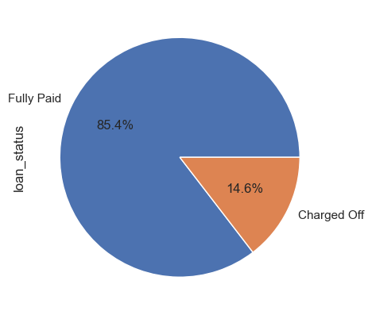
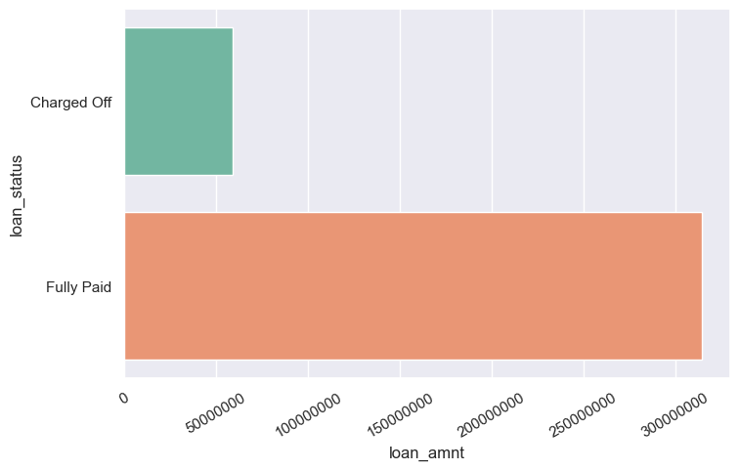
How Pervasive is Default
Nearly 15% of loans through the lending club are charged off (defaulted). This resulted in a total value loss of almost $60 million.

Slide 4
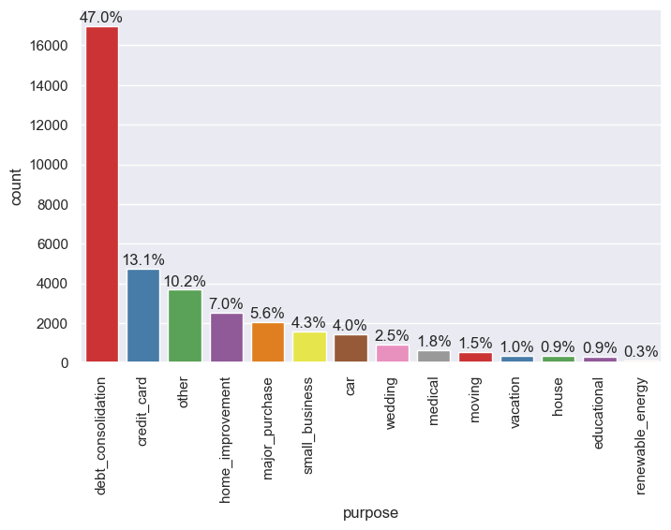
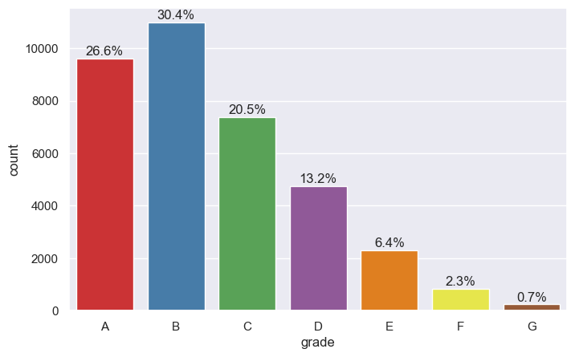
The Loan Characteristics
More than 80% of loans are issued in just 5 categories with debt consolidation accounting for 47% of all provided reasons
Higher grade loans are more commonly issued to applicants with Grades A and B accounting for 57% of loans

Slide 5
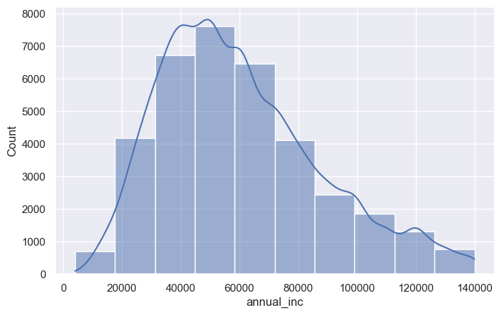
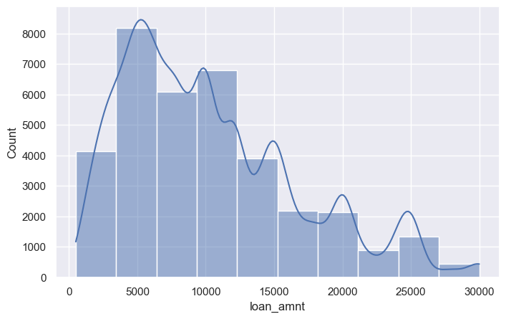
Characteristics Cont’D
Most applicants have incomes lower than the dataset average of $60K.
Most loans requested are $10K or less.
Loans $5K and 10K are most frequently requested

Slide 6
Default Risk Factors

